Slide 1
DAG, Confounding & Interaction
Friday, 06 February 2025

Slide 2
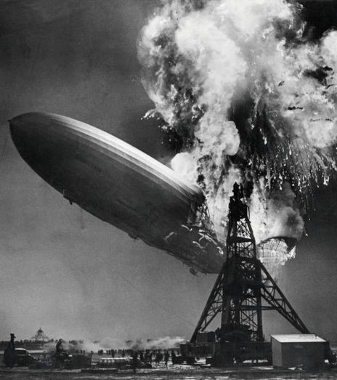
Outline
DAG diagrams
Confounders
Interactions

Slide 3
objectives
Define and sketch a causal diagram using directed acyclic graphs (DAG)
Explain the properties of a confounder
Identify a confounder along the DAG
Explain the methods for controlling a confounder
Explain the properties of effect modification
Identify an effect modification along the DAG
Explain the methods for addressing an effect modifier

Slide 4

Directed acyclic graph (DAG)
A directed acyclic graph (DAG) is a visual representation of the causal relations that make the underlying relationships between factors explicit
A cause is a factor that produces an effect on another factor
A directed path is a sequence of arrows in which every arrow points in the same direction (no closed loop)
E
O
Judea Pearl

Slide 5
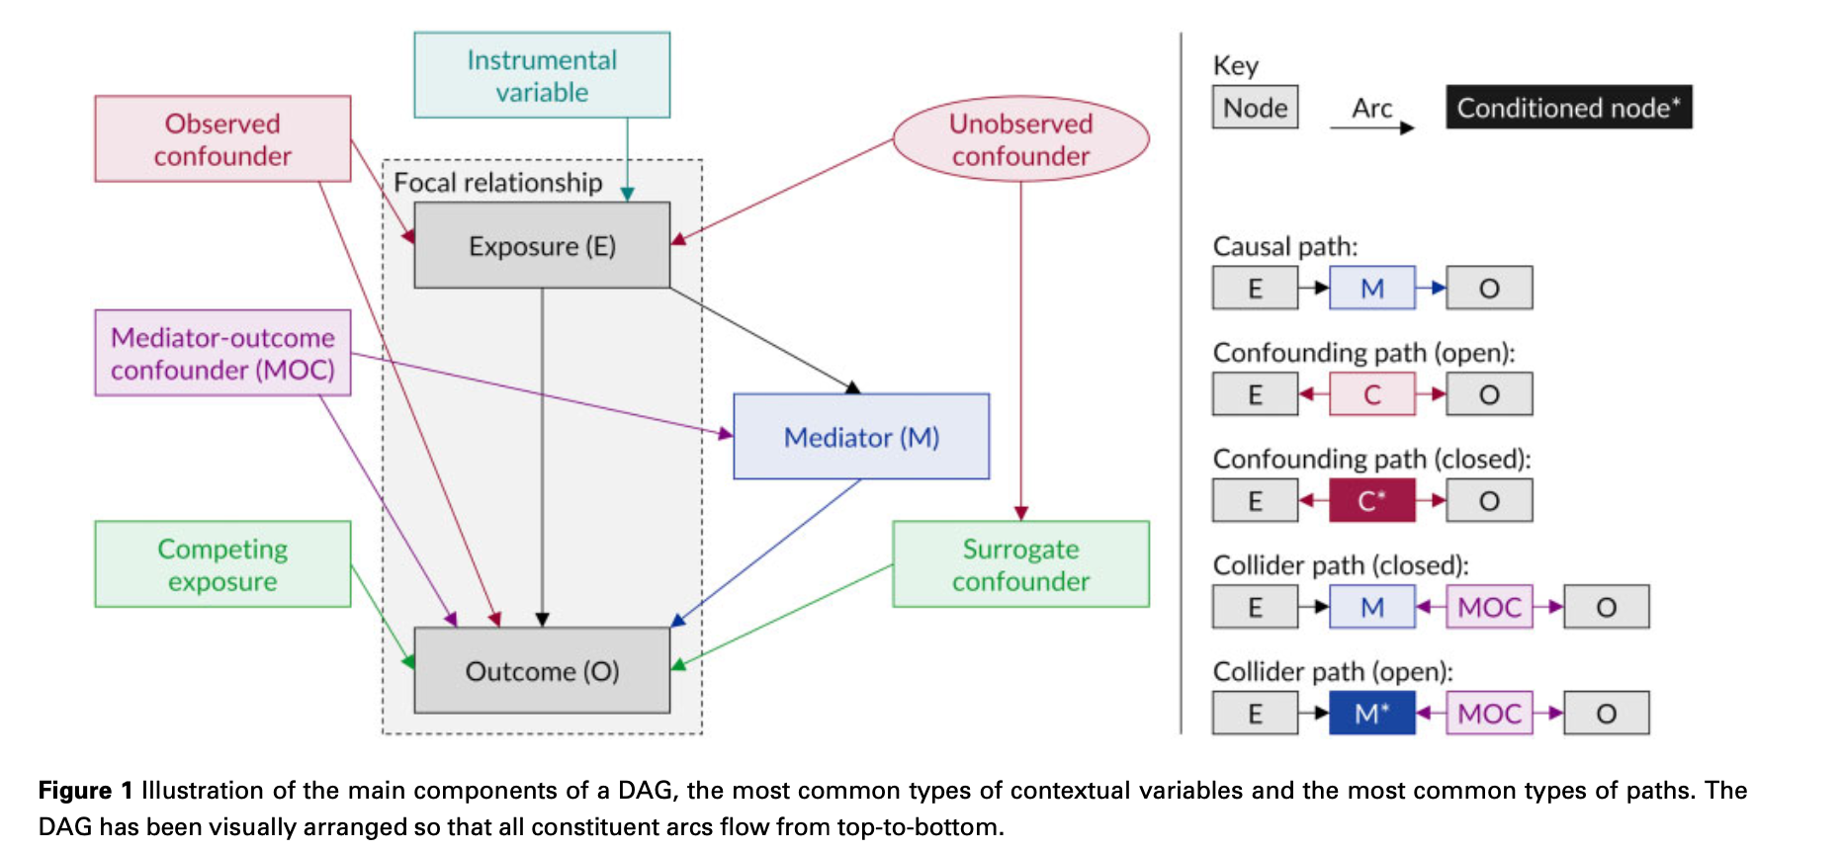
Directed acyclic graph (DAG)—Example
Tennant, et al. International Journal of Epidemiology. 2021:50(2):620-632.

Slide 6
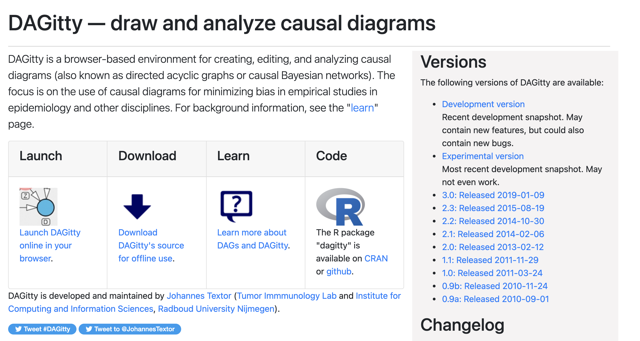
DAGitty (draw Your own dag diagrams)
http://www.dagitty.net/

Slide 7
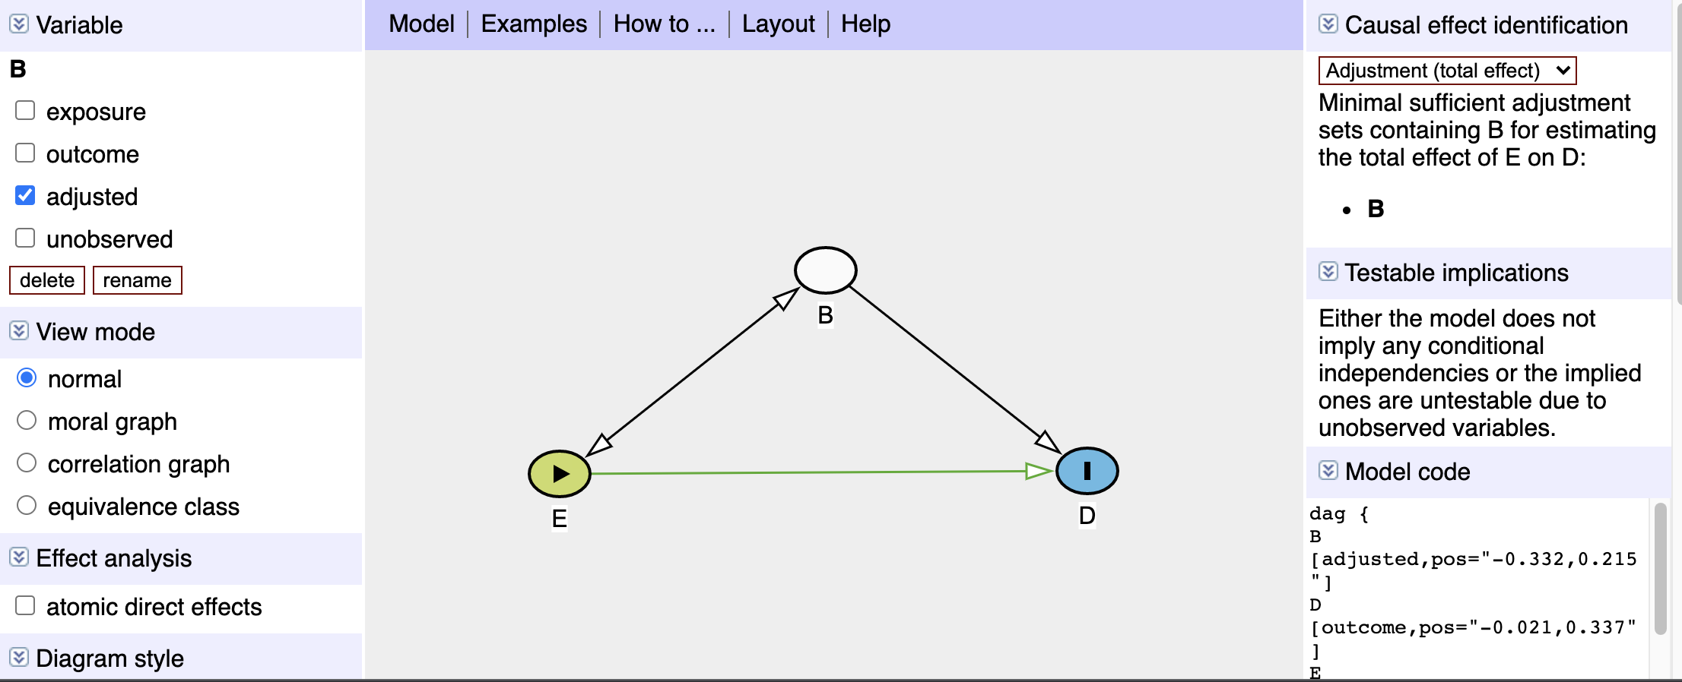
DAGitty (draw Your own dag diagrams)—confounder ex.
http://www.dagitty.net/

Slide 8
Types of biases (1)
Bias is any systematic error in an epidemiologic study that results in an incorrect estimate of the association between exposure and the health outcome.
Selection bias
Non-random sampling bias
Responder bias (Non-responder bias)
Berkson’s bias
Information bias
Measurement bias
Misclassification bias
Hawthorne effect

Slide 9
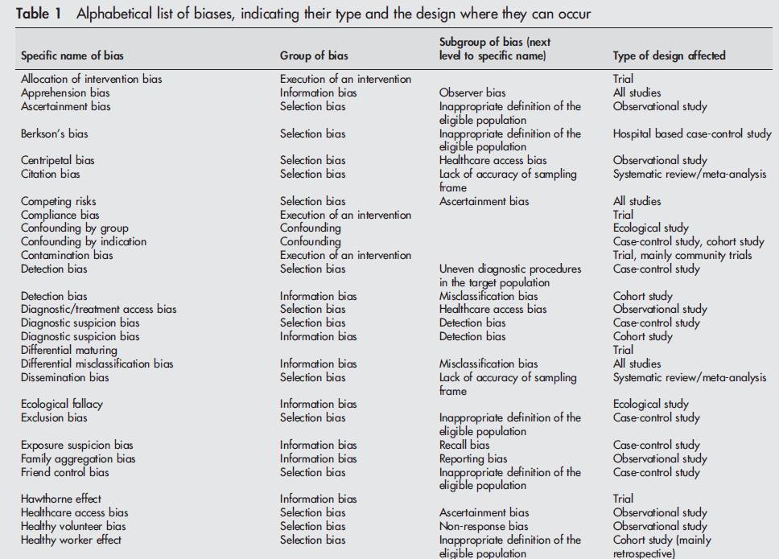
Types of biases (2)
Journal of Epidemiology & Community Health 2004;58:635-641

Slide 10
Three types of bias, thus far…
Selection bias
Non-random sampling bias
Responder bias (Non-responder bias)
Berkson’s bias
Information bias
Measurement bias
Misclassification bias
Hawthorne effect
Confounding

Slide 11
confounder
A confounder is a distortion of the relationship between the exposure and outcome; it is a factor that is associated with the exposure and the outcome but not in the causal path between the exposure and outcome
A confounder has three criteria:
Have an association with the outcome (must be a risk factor for the outcome)
Have an association with the exposure
Must not be in the causal path from the exposure to the outcome
C
E
O

Slide 12
Study design methods to control for confounding
Randomization: Eliminates links between the exposure and confounders (observed an unobserved)
Matching on the confounder: Balance the confounder between the groups
Restrict the sample: Focus on subjects with the same covariates (e.g., age, sex)
Statistical analyses: Mantel-Haenszel (MH) adjustment (stratification) and multivariable regression models

Slide 13
Motivating example: simpson’s paradox
Simpson’s paradox is a statistical phenomena where the association of two factors may be independent or reversed when stratified into subgroups
Example from Charig (1986), which treatment is better at improving survival?
 | Large stones | Small stones | Total
Old treatment | 192 / 263 = 73% | 81 / 87 = 93% | 273 / 350 = 78%
New treatment | 55 / 80 = 69% | 234 / 270 = 87% | 289 / 350 = 83%
Stone size
Surgeons were biased in their treatment selection; they preferred to treat patients with smaller stones with the newer treatment
Treatment
Success

Slide 14
Motivating example: Ice Cream and Sunburn
Let’s look at the proposed causal relationship
Does ice cream cause sunburn?
Ice cream
Sun burn
Temperature

Slide 15
Motivating example: down syndrome and birth order (1)
Let’s look at the proposed causal relationship
Does birth order cause Down syndrome?
Birth order
Down syndrome
Stark and Mantel (1996)

Slide 16
Motivating example: down syndrome and birth order (2)

Slide 17
Motivating example: down syndrome and birth order (3)

Slide 18
Motivating example: down syndrome and birth order (4)

Slide 19
Motivating example: down syndrome and birth order (5)
Let’s look at the proposed causal relationship
Does birth order cause Down syndrome?
Birth order
Down syndrome
Maternal age

Slide 20
Motivating example: Cholesterol and death (1)
Let’s look at the proposed causal relationship
Does high cholesterol increase death?
Cholesterol
Death
Exercise

Slide 21
Motivating example: Cholesterol and death (2)
Cholesterol
Death
 | Death = 1 | Death = 0 | Total
High chol | 250 | 2000 | 2250
Low chol | 150 | 1500 | 1650
RR = 1.22; 95% CI: 1.01, 1.48
OR = 1.25; 95% CI: 1.01, 1.55

Slide 22
Motivating example: Cholesterol and death (3)
Cholesterol
Death
Exercise
 | Death = 1 | Death = 0 | Total
Exercise | 200 | 2400 | 2600
No exercise | 200 | 1100 | 1300
Criterion 1: Have an association with the outcome (must be a risk factor for the outcome)
RR = 0.50; 95% CI: 0.42, 0.60
OR = 0.46; 95% CI: 0.37, 0.56

Slide 23
Motivating example: Cholesterol and death (4)
Cholesterol
Death
Criterion 3: Not on the causal pathway
Exercise
 | High cholesterol | Low cholesterol | Total
Exercise | 1750 | 850 | 2600
No exercise | 500 | 800 | 1300
Criterion 2: Have an association with the exposure
RR = 1.75; 95% CI: 1.63, 1.88
OR = 3.29; 95% CI: 2.87, 3.78

Slide 24
Motivating example: Cholesterol and death (5)
Stratum 1
Exercise (N = 2600) | Death = 1 | Death = 0 | Total
High chol | 150 | 1600 | 1750
Low chol | 50 | 800 | 850
RR = 1.45; 95% CI: 1.07, 1.99
OR = 1.50; 95% CI: 1.08, 2.09
Stratum 2
No Exercise (N = 1300) | Death = 1 | Death = 0 | Total
High chol | 100 | 400 | 500
Low chol | 100 | 700 | 800
RR = 1.60; 95% CI: 1.24, 2.06
OR = 1.75; 95% CI: 1.29, 2.37

Slide 25



Motivating example: Cholesterol and death (6)
Stratum 1
Exercise (N = 2600) | Death = 1 | Death = 0 | Total
High chol | 150 (a) | 1600 (b) | 1750
Low chol | 50 (c) | 800 (d) | 850
${RR}_{adjusted}=\frac{\sum{\frac{a_{i}\left(c_{i}+d_{i}\right)}{n_{i}}}}{\sum{\frac{c_{i}\left(a_{i}+b_{i}\right)}{n_{i}}}}$
Stratum 2
No Exercise (N = 1300) | Death = 1 | Death = 0 | Total
High chol | 100 (a) | 400 (b) | 500
Low chol | 100 (c) | 700 (d) | 800
${RR}_{adjusted}=\frac{\frac{150(50+800)}{2600}}{\frac{50(150+800)}{2600}}+\frac{\frac{100(100+700)}{1300}}{\frac{100(100+400)}{1300}}$
$${RR}_{adjusted}=1.53$$

Slide 26

Motivating example: Cholesterol and death (7)
Stratum 1
Exercise (N = 2600) | Death = 1 | Death = 0 | Total
High chol | 150 | 1600 | 1750
Low chol | 50 | 800 | 850
RR = 1.45; 95% CI: 1.07, 1.99
Stratum 2
No Exercise (N = 1300) | Death = 1 | Death = 0 | Total
High chol | 100 | 400 | 500
Low chol | 100 | 700 | 800
RR = 1.60; 95% CI: 1.24, 2.06
${RR}_{adjusted}=$1.53; 95% CI: 1.26, 1.87)

Slide 27



Motivating example: Cholesterol and death (8)
Stratum 1
Exercise (N = 2600) | Death = 1 | Death = 0 | Total
High chol | 150 (a) | 1600 (b) | 1750
Low chol | 50 (c) | 800 (d) | 850
${OR}_{adjusted}=\frac{\sum{\frac{a_{i}d_{i}}{n_{i}}}}{\sum{\frac{c_{i}b_{i}}{n_{i}}}}$
Stratum 2
No Exercise (N = 1300) | Death = 1 | Death = 0 | Total
High chol | 100 (a) | 400 (b) | 500
Low chol | 100 (c) | 700 (d) | 800
$${OR}_{adjusted}=\frac{\frac{(150)(800)}{2600}}{\frac{(50)(1600)}{2600}}+\frac{\frac{(100)(700)}{1300}}{\frac{(100)(400)}{13000}}$$
${OR}_{adjusted}=$1.63

Slide 28

Motivating example: Cholesterol and death (9)
Stratum 1
Exercise (N = 2600) | Death = 1 | Death = 0 | Total
High chol | 150 | 1600 | 1750
Low chol | 50 | 800 | 850
OR = 1.50; 95% CI: 1.08, 2.09
Stratum 2
No Exercise (N = 1300) | Death = 1 | Death = 0 | Total
High chol | 100 | 400 | 500
Low chol | 100 | 700 | 800
OR = 1.75; 95% CI: 1.29, 2.37
${OR}_{adjusted}=$1.63; 95% CI: 1.30, 2.03)

Slide 29


Motivating example: Cholesterol and death (10)
Cholesterol
Death
Exercise
 | Death = 1 | Death = 0 | Total
High chol | 250 | 2000 | 2250
Low chol | 150 | 1500 | 1650
RR = 1.22; 95% CI: 1.01, 1.48
OR = 1.25; 95% CI: 1.01, 1.55
${RR}_{adjusted}=$1.53; 95% CI: 1.26, 1.87)
${OR}_{adjusted}=$1.63; 95% CI: 1.30, 2.03)

Slide 30





Is there confounding?
There is no statistical test for confounding, but there is an “informal” 10% rule
$$Magnitude of confounding= \frac{{RR}_{crude}−{RR}_{adjusted}}{{RR}_{adjusted}}$$
RR = 1.22; 95% CI: 1.01, 1.48
OR = 1.25; 95% CI: 1.01, 1.55
${RR}_{adjusted}=$1.53; 95% CI: 1.26, 1.87
${OR}_{adjusted}=$1.63; 95% CI: 1.30, 2.03
$$RR: −0.20=\frac{1.22 −1.53}{1.53}$$
$$OR: −0.23=\frac{1.22 −1.63}{1.63}$$

Slide 31
Controlling for confounding
https://www.explainxkcd.com/wiki/index.php/2560:_Confounding_Variables

Slide 32
Interaction (effect modification)
Effect modification describes a phenomenon where the effect of an independent variable (X) on a dependent variable (Y) varies across levels of a moderating variable (Z)
Z
X
Y

Slide 33
Motivating example: effect modification (1)
Let’s assume that we have Stress Level (High versus Low) that is an effect modifier on the Cholesterol to Death relationship
Cholesterol
Death
Stress Level

Slide 34
Motivating example: effect modification (2)
Stratum 1
High Stress (N = 2650) | Death = 1 | Death = 0 | Total
High chol | 250 | 1500 | 1750
Low chol | 75 | 825 | 900
RR = 1.71; 95% CI: 1.34, 2.19
OR = 1.83; 95% CI: 1.40, 2.41
Stratum 2
Low Stress (N = 1250) | Death = 1 | Death = 0 | Total
High chol | 25 | 425 | 450
Low chol | 100 | 700 | 800
RR = 0.44; 95% CI: 0.29, 0.68
OR = 0.41; 95% CI: 0.26, 0.65

Slide 35
Motivating example: effect modification (3)
When effect modification is present, it is best to present the findings (e.g., RR and OR) as separate strata
In this example, you should present the RR and OR separately for those who have High Stress and Low Stress

Slide 36
conclusions
We can never get all the confounders and effect modifiers (observed and unobserved)
But we can try to address the ones that are obvious (measurable)
DAGs help us identify the obvious confounders and effect modifiers a priori
Using the M-H adjusted RR and OR is a statistical method to address confounders, but study design methods are preferred (e.g., randomization, restricted sample, and matching on the confounder)
If we are unable to control or adjust for potential confounders and effect modifiers, we need to be careful how we interpret our findings (e.g., threats to internal validity)

Slide 37

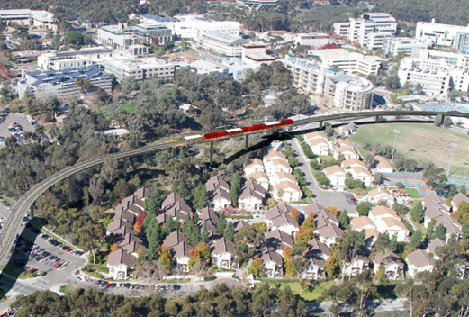
ADDITIONAL RESOURCES
Mantel-Haenzsel method (Boston University)
Tutorial on epitools and confounding and effect modification
R Document for epiR package
DAGitty (website)
Mediation analysis

